Slide 1
MCTV Limited
22nd April
2017
Presented by: Grigor Danut, Antonio Penna, Jack Gallaher and Dylan Gilroy.

Slide 2
Agenda
Jack
The purpose of this presentation was to explore the development of MCTV Limited.
We as a group were given particular tasks in which we all had to take part in.
This presentation will feature a quick background on MCTV Limited, the UML charts, Databases, Gantt charts, the company Website.

Slide 3
Introduction to Company
Jack
With the headquarter in Dublin, MCTV Limited have been manufacturing TV’s since 1955
MCTV use only the highest quality components
Supporting the local job markets and growing local industries

Slide 4
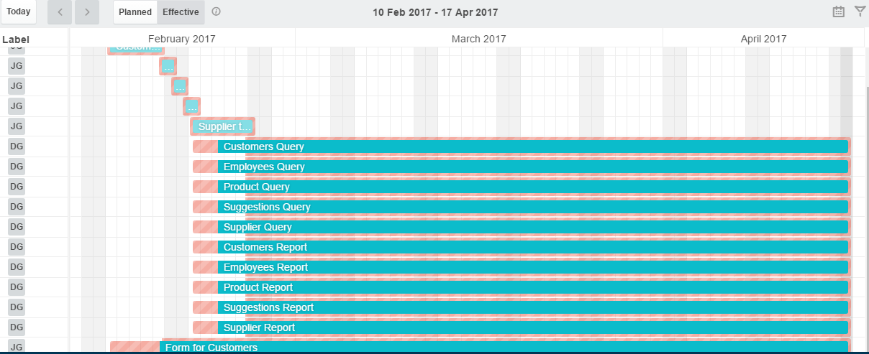
Gantt Chart
Jack
The Gannt charts shows the progression of the groups Trello boards over the last few months
Microsoft Databases

Slide 5
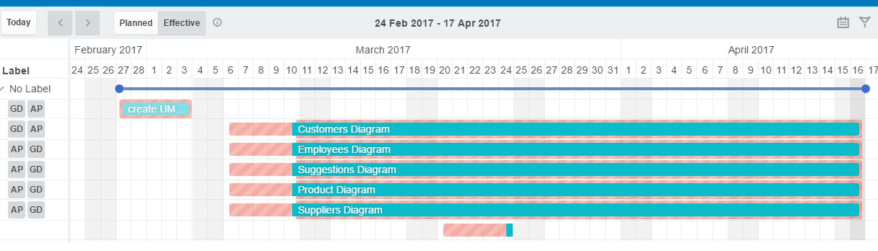
Gantt Chart
Jack
UML Charts

Slide 6
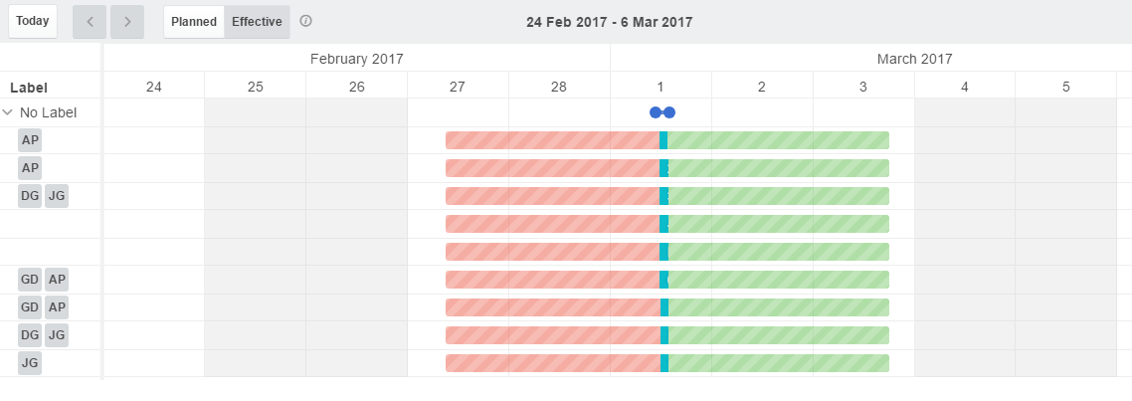
Gantt Chart
Jack
Presentation

Slide 7
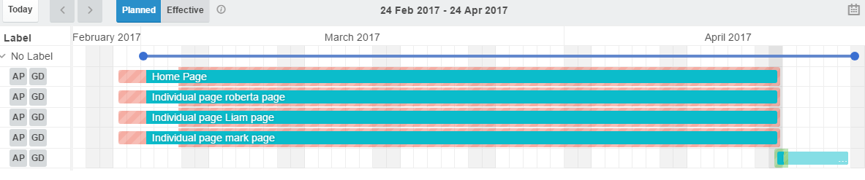
Gantt Chart
Jack
Word Press

Slide 8




User Guides
Jack
Grigor Danut - Sage 50
Jack Gallaher – Salesforce
Antonio Penna – Woo Commerce
Dylan Gilroy – Trello

Slide 9
Individual Task
Dylan
Databases – Dylan Gilroy and Jack Gallaher
UML charts – Antonio Penna and Grigor Danut
WordPress – Antonio Penna and Grigor Danut
Trello – Jack Gallaher
Presentation slides– Antonio Penna–layout, front page, introduction
Jack Gallaher-Agenda, Gantt chart, Conclusion, Last slide
Grigor Daunt-UML charts, Databases
Dylan Gilroy-individual Tasks, Website, User Guide

Slide 10
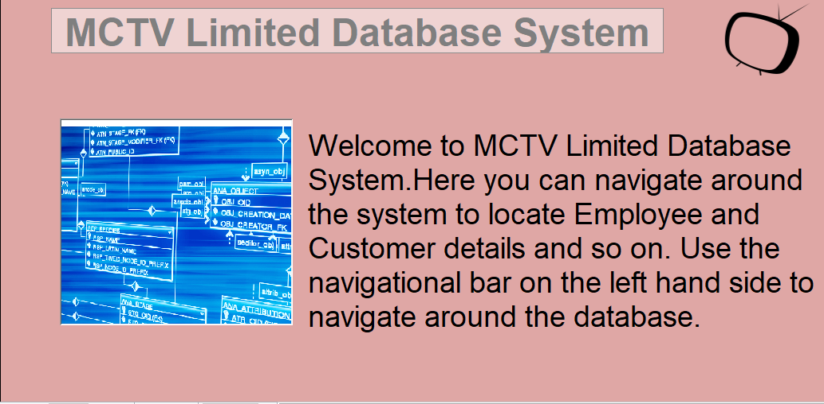
MCTV Limited
Dylan

Slide 11
Databases
Dylan
Tables
Queries
Forms
Reports
Macros

Slide 12
Tables
Dylan
Customers Table
Employees Table
Suggestions Table
Suppliers Table
Products Table

Slide 13
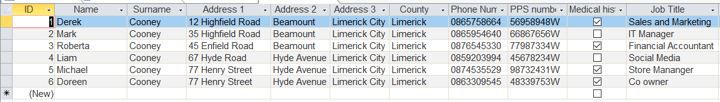
Employees Table
Dylan

Slide 14
Queries
Dylan
Customers from Dublin
Employees with Medical Card
Products (bills) not paid
Orders by year 2016
Orders by year 2017
Out of Stock
Products with Stock Value more than €4000
Suggestions Query
Suppliers Query

Slide 15
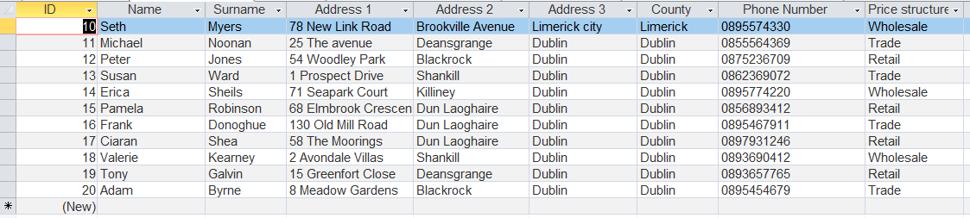
Orders by year 2016
Dylan

Slide 16
Forms
Dylan
Customers Form
Employees Form
Navigation Form
Products Form
Suggestions Form
Suppliers Form
Welcome Page

Slide 17
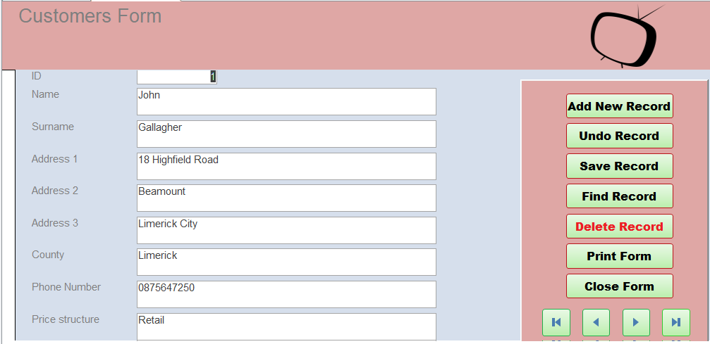
Customers Form
Grigor

Slide 18
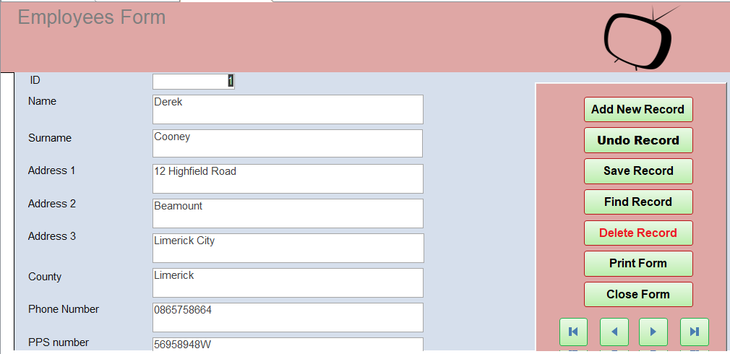
Employees Form
Grigor

Slide 19
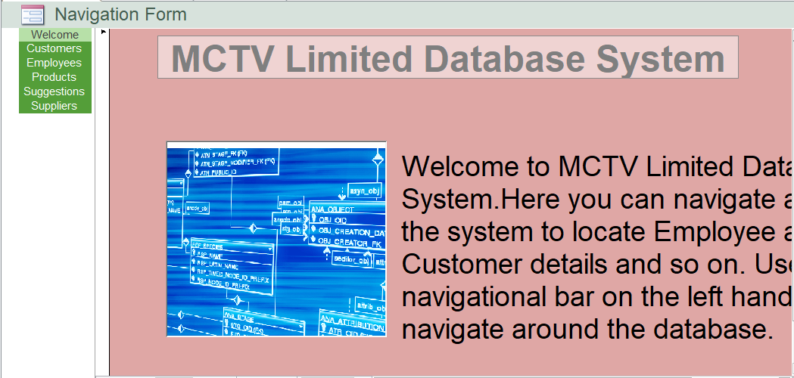
Navigation Form
Grigor

Slide 20
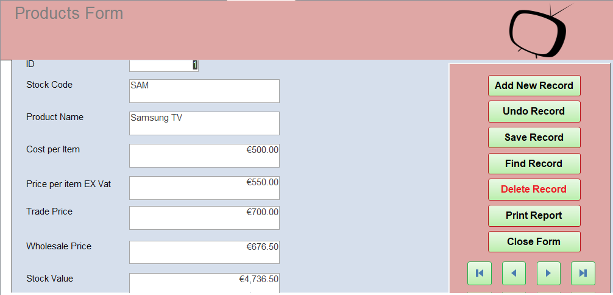
Products Form
Grigor

Slide 21
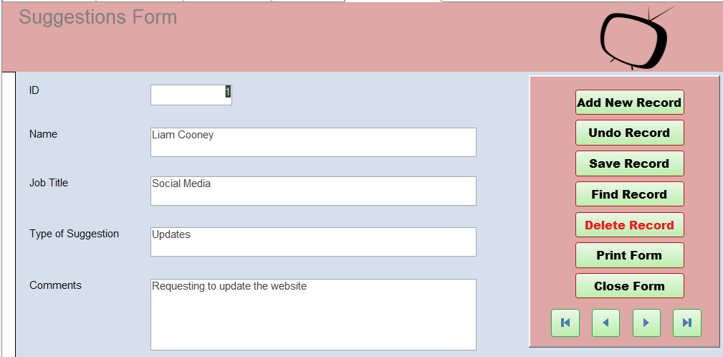
Suggestions Form
Grigor

Slide 22
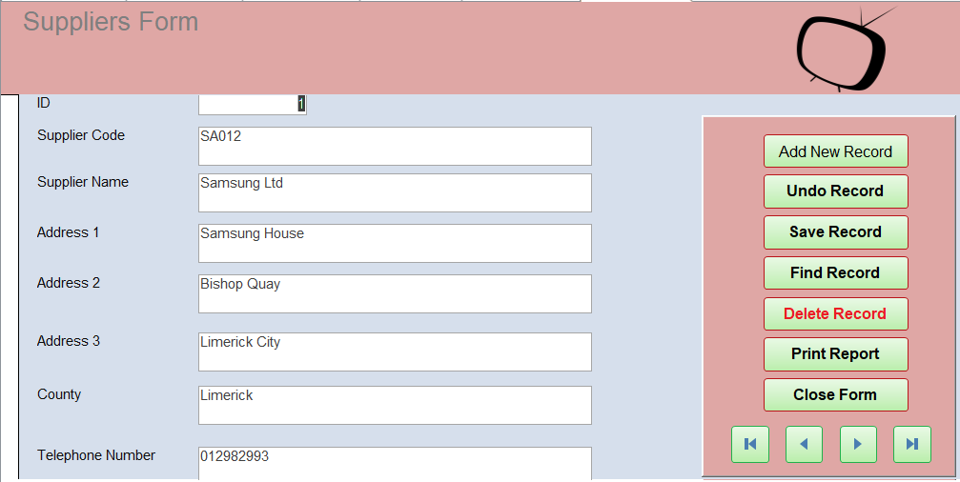
Suppliers Form
Grigor

Slide 23
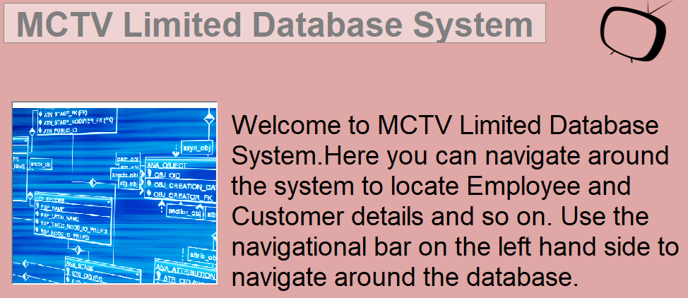
Welcome Page
Dylan

Slide 24
Reports
Dylan
Accounts Overdue Report
Customers Report
Employees Report
Products Report
Suggestions Report
Suppliers Report

Slide 25
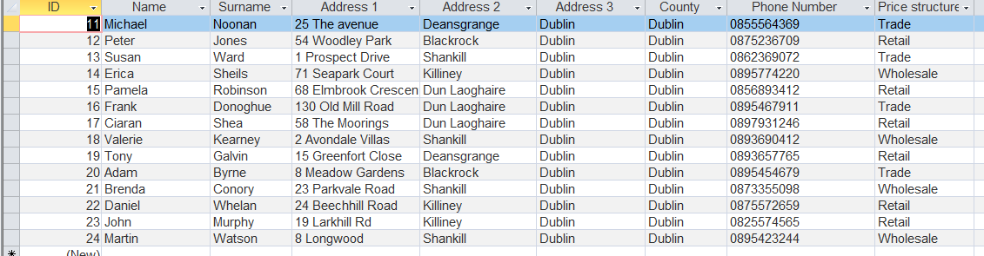
Customers from Dublin
Dylan

Slide 26
UML chart
Grigor
Customers Table
Employees Table
Navigation Form
Products Table
Suggestions Table
Suppliers Table

Slide 27
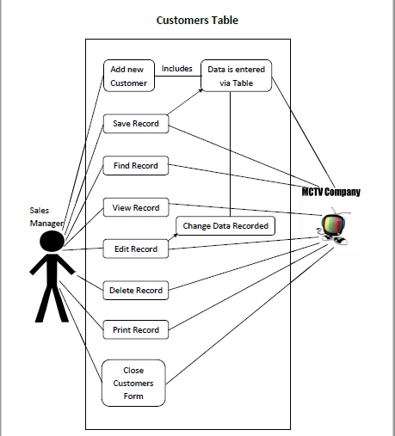
Customers Table
Grigor

Slide 28
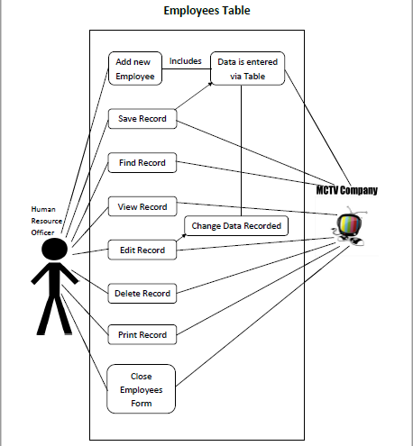
Employees Table
Grigor

Slide 29
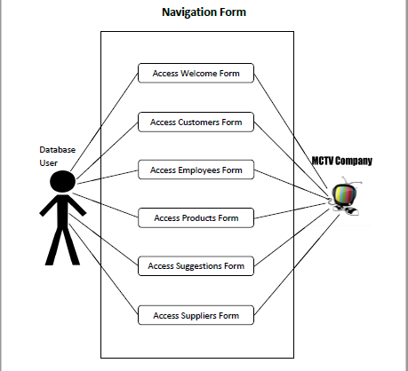
Navigation Form
Grigor

Slide 30
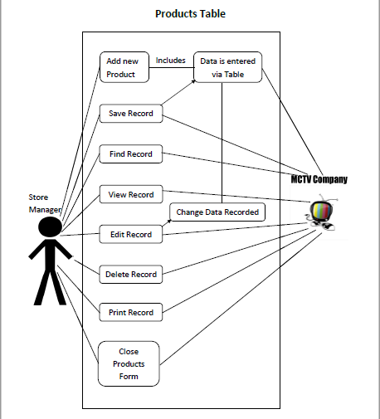
Products Table
Grigor

Slide 31
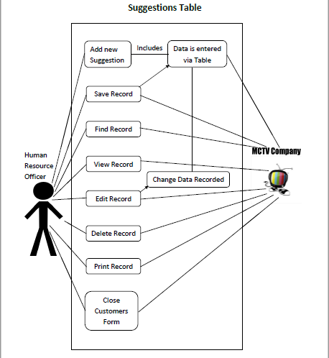
Suggestions Table
Grigor

Slide 32
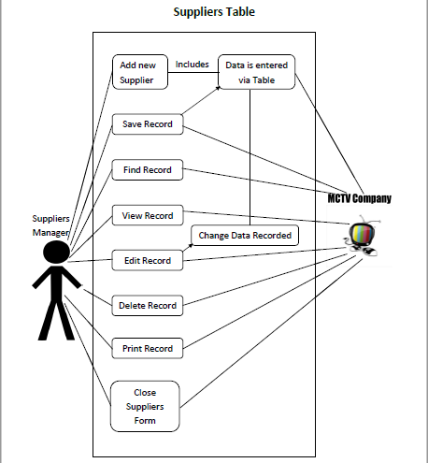
Suppliers Table
Grigor

Slide 33
Website
Antonio
Here we will present to you the MCTV Limited Website
Which will feature a Home page and 4 individual pages about the workers in the shop

Slide 34

Userguide
Antonio

Slide 35
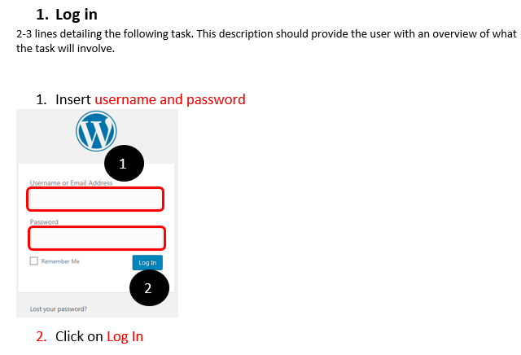
Userguide
Antonio

Slide 36
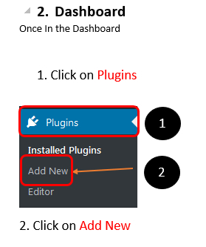
Userguide
Antonio

Slide 37
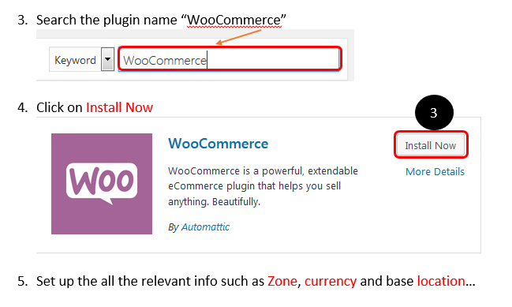
Userguide
Antonio

Slide 38
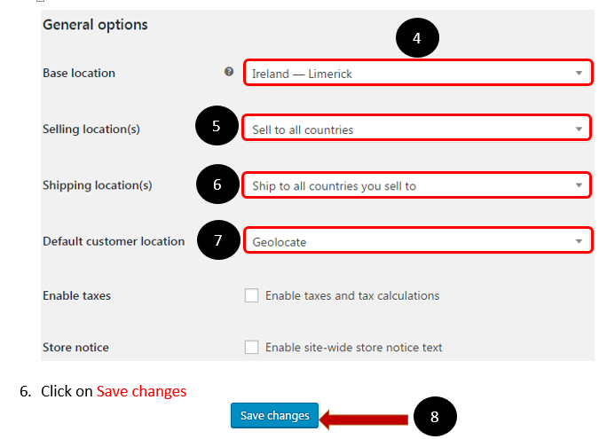
Userguide
Antonio

Slide 39
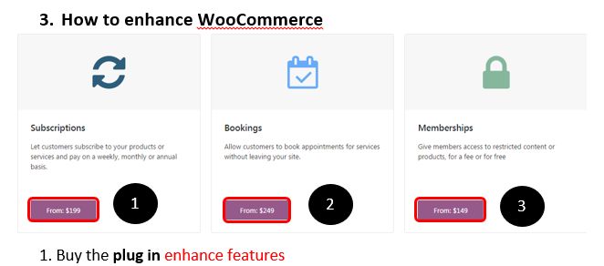
Userguide
Antonio

Slide 40
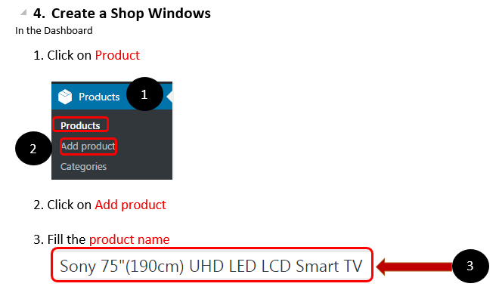
Userguide
Antonio

Slide 41
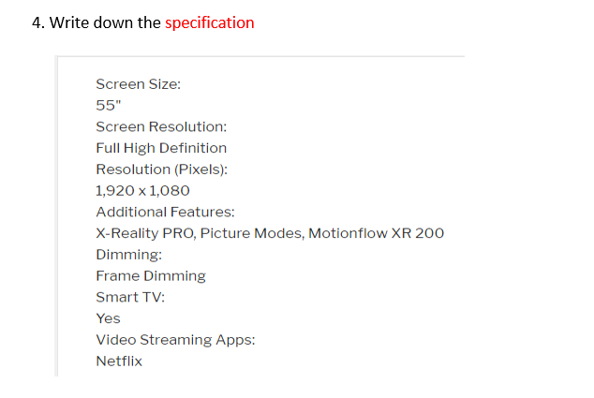
Userguide
Antonio

Slide 42
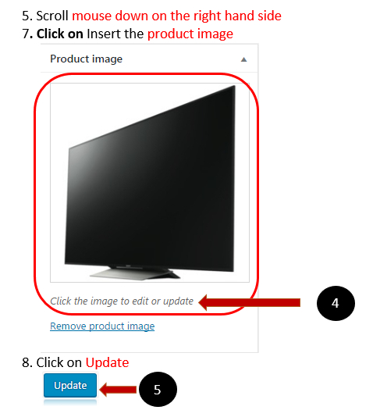
Userguide
Antonio

Slide 43
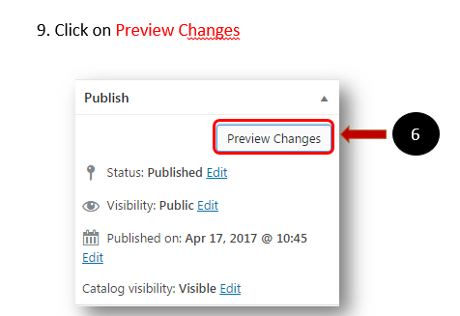
Userguide
Antonio

Slide 44
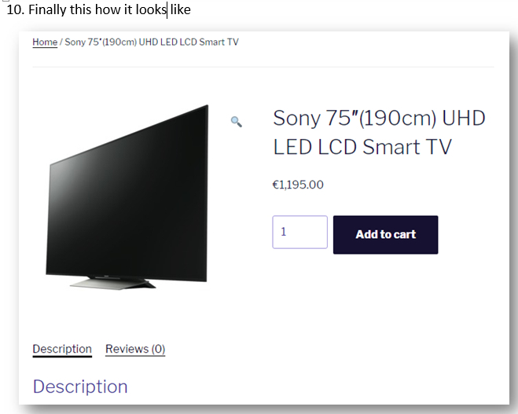
Userguide
Antonio

Slide 45
Conclusion
Antonio
MCTV Limited will continue to grow as a company in future
It is aimed for the company to become more efficient as it moves to the cloud.
As cloud technology improves further into the future MCTV limited will follow and become a larger and better company.

Slide 46

Questions?
Everyone
Thank you for listening
Any Questions?

